Slide 1


Slide 2
TOPICS
TEDIT
TACL
FUP
DDL
FILE TYPES

Slide 3
TEDIT
To edit the readable files on tandem
Creating a File
TACL > Tedit <filename>
$VOLUME.SUBVOLUME.FILENAME doesn't exist. OK to create? Respond Y or N:
This would create a new blank file.
Same command for opening an existing file
To open the file in read mode the command is
TACL > Tedit <filename> ,r

Slide 4
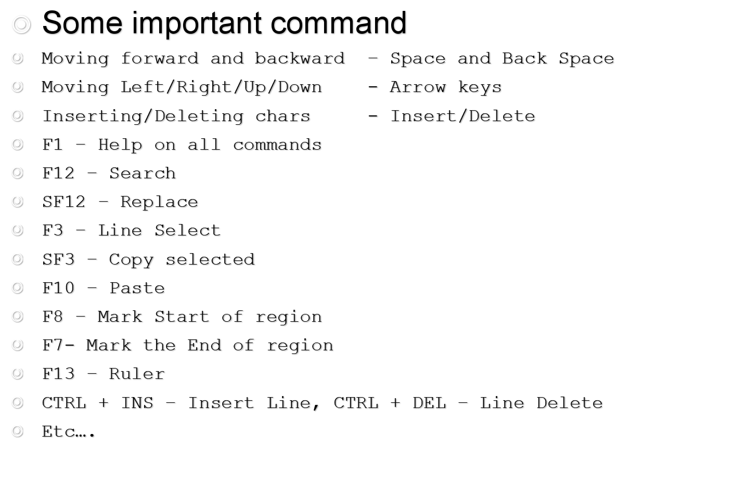
TEDIT

Slide 5
TEDIT

Slide 6
TEDIT
Some important command
Moving forward and backward – Space and Back Space
Moving Left/Right/Up/Down - Arrow keys
Inserting/Deleting chars - Insert/Delete
F1 – Help on all commands
F12 – Search
SF12 – Replace
F3 – Line Select
SF3 – Copy selected
F10 – Paste
F8 – Mark Start of region
F7- Mark the End of region
F13 – Ruler
CTRL + INS – Insert Line, CTRL + DEL – Line Delete
Etc….

Slide 7




Slide 8


Slide 9
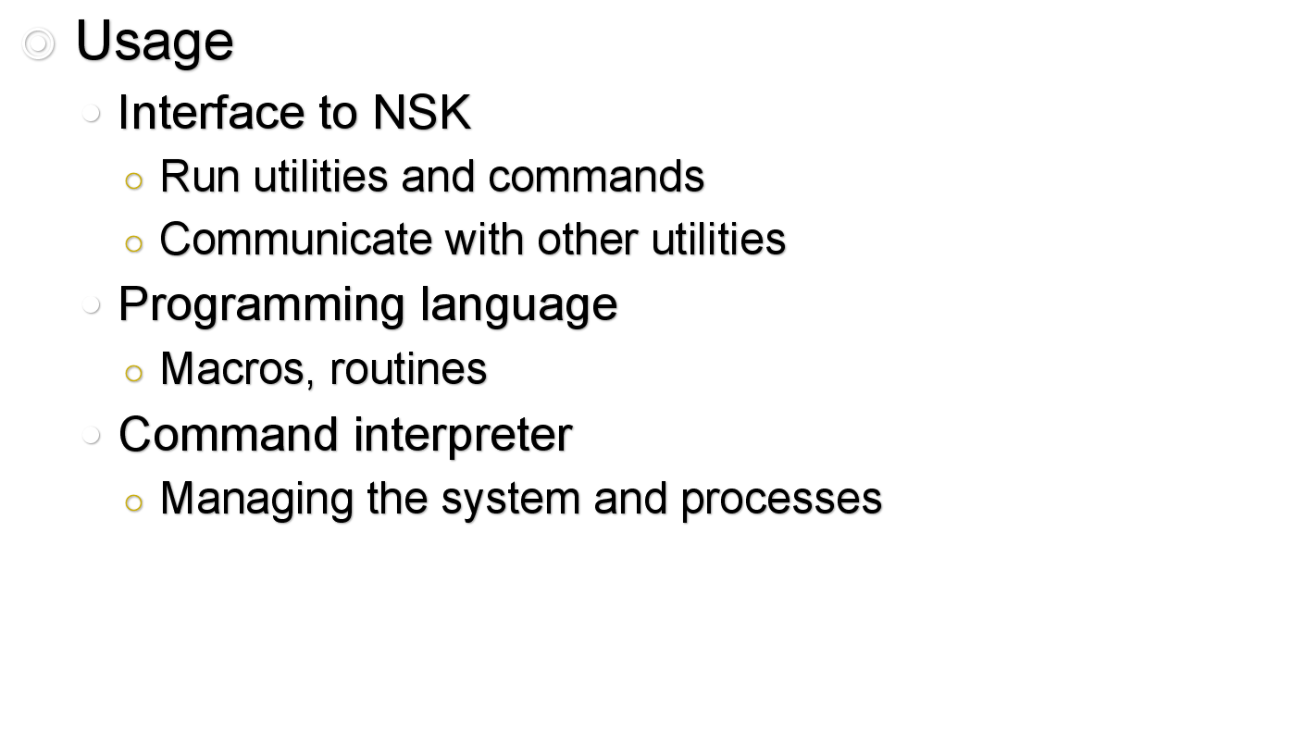
TACL

Slide 10



Slide 11
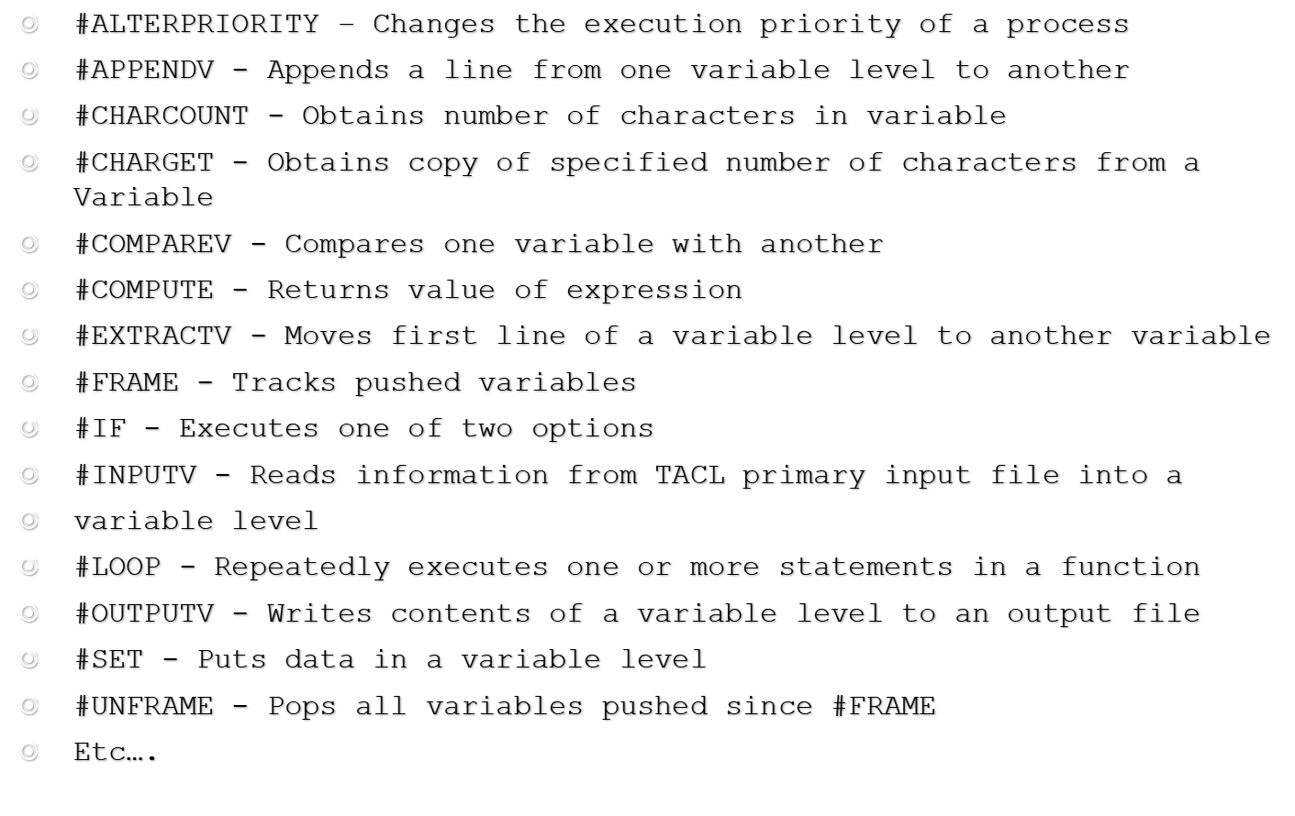
TACL –FUNCTIONS

Slide 12
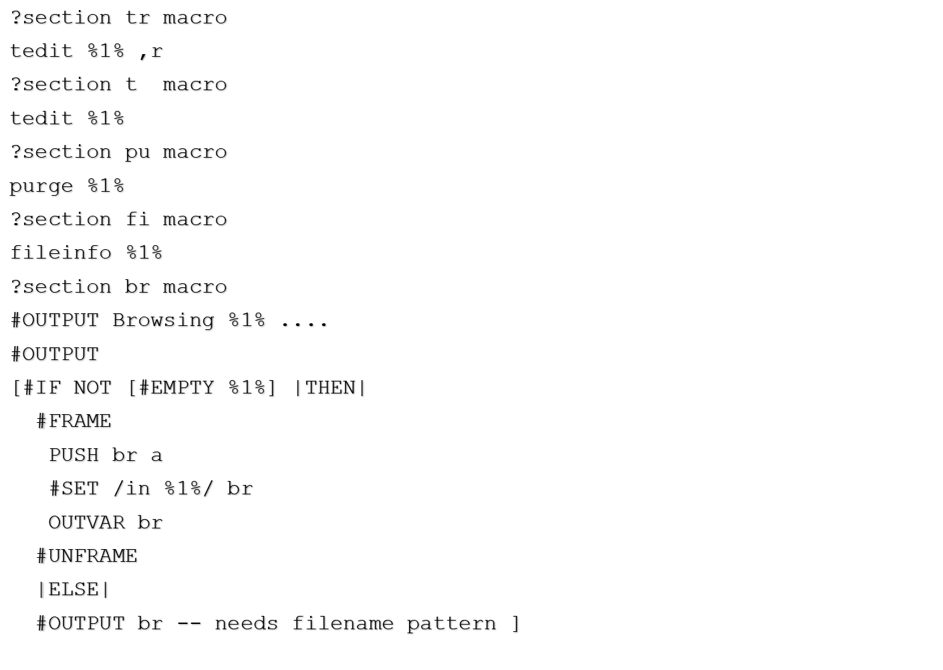
TACL - Examples

Slide 13

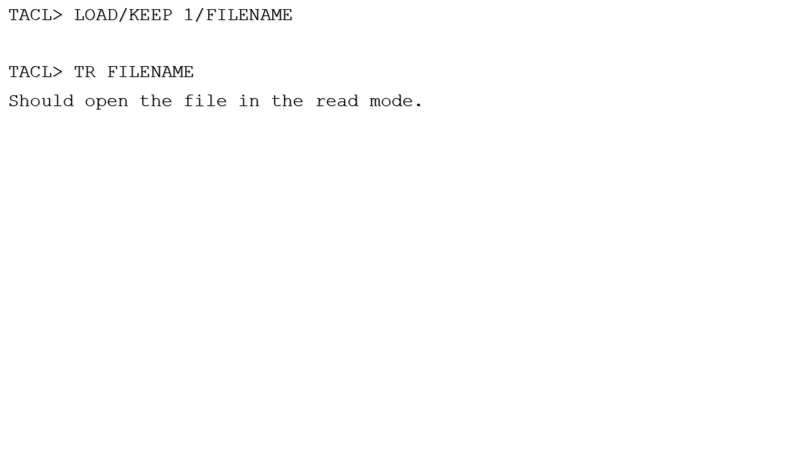

Slide 14



Slide 15


Slide 16

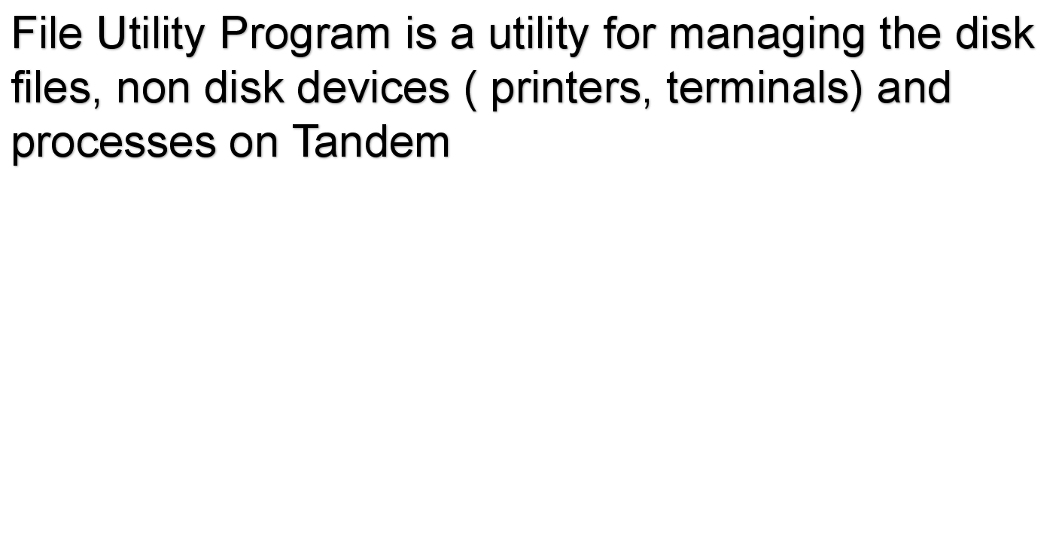

Slide 17
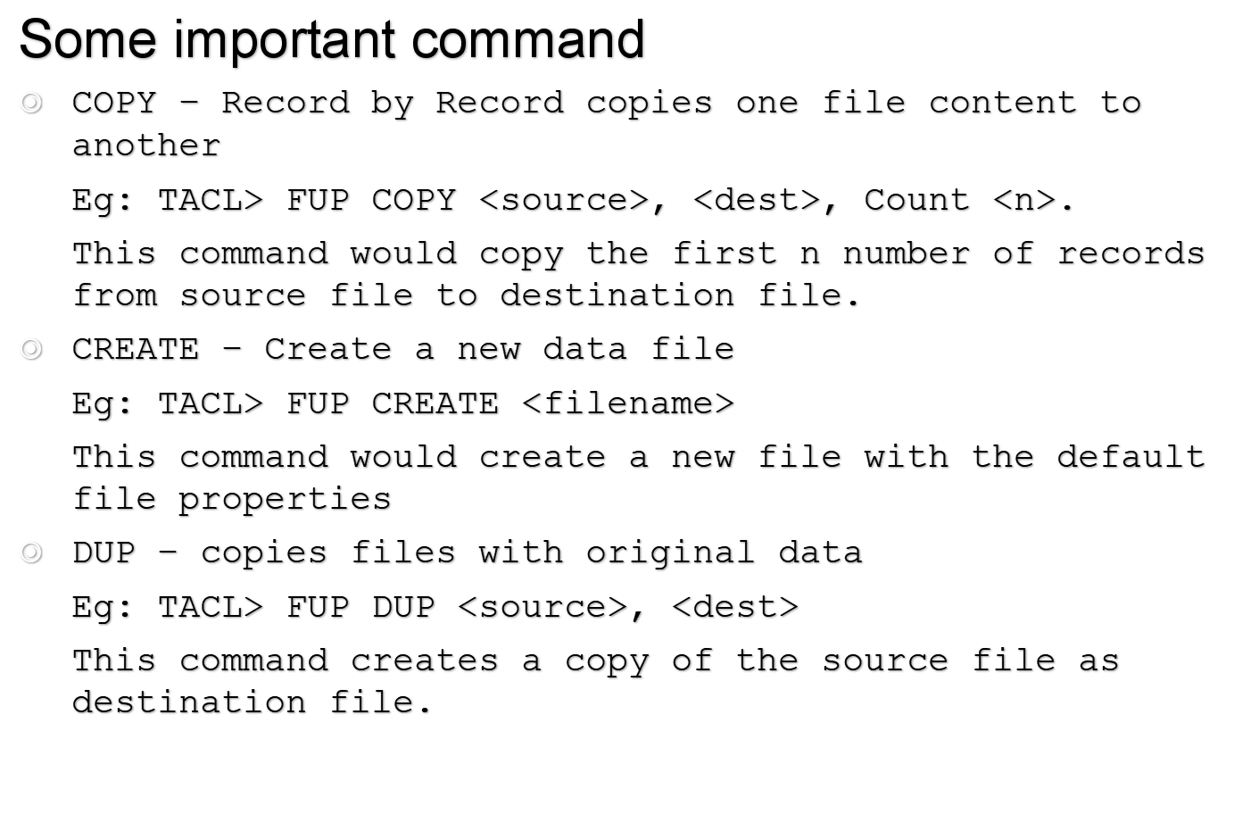
FUP

Slide 18
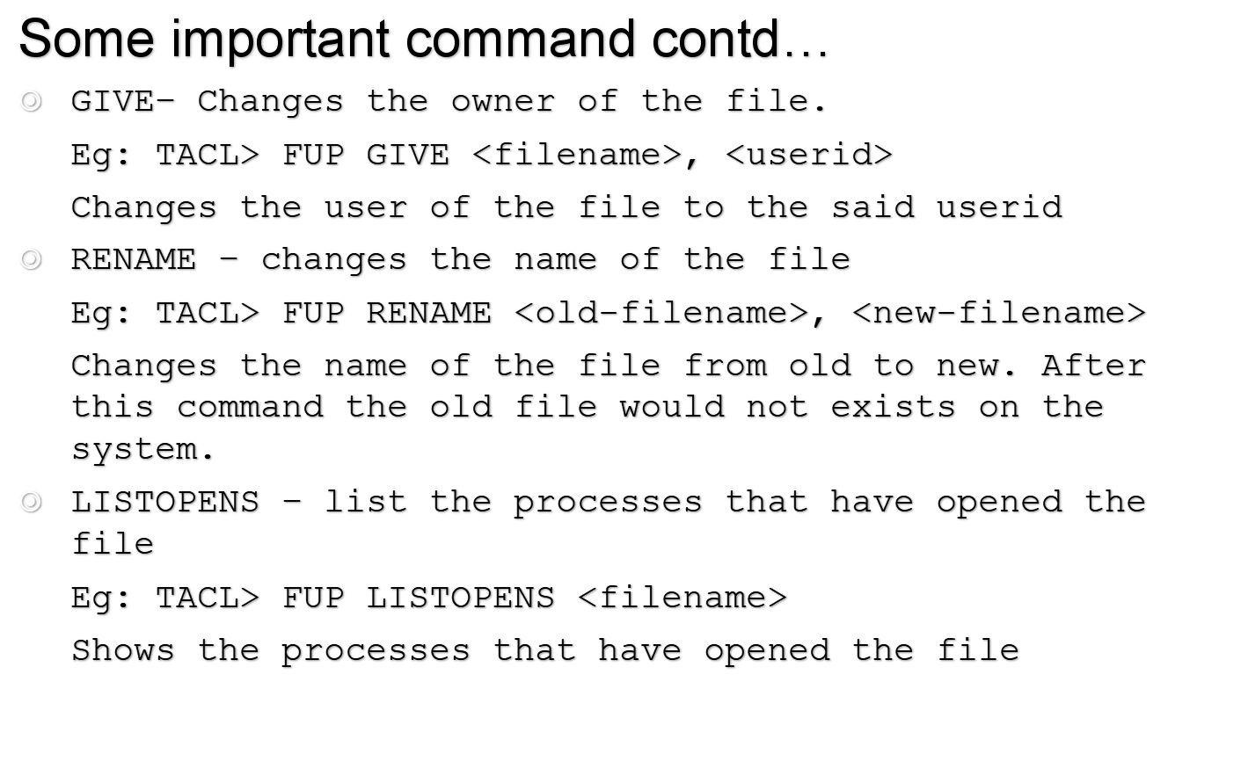
FUP

Slide 19
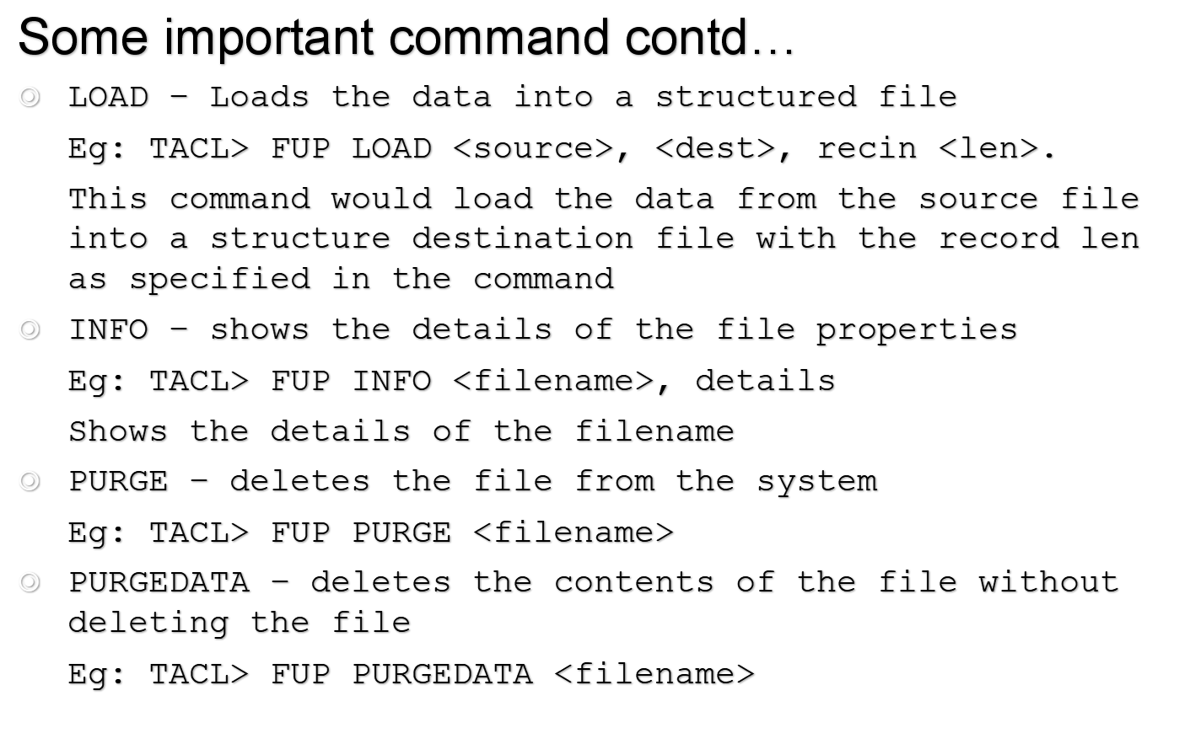
FUP

Slide 20
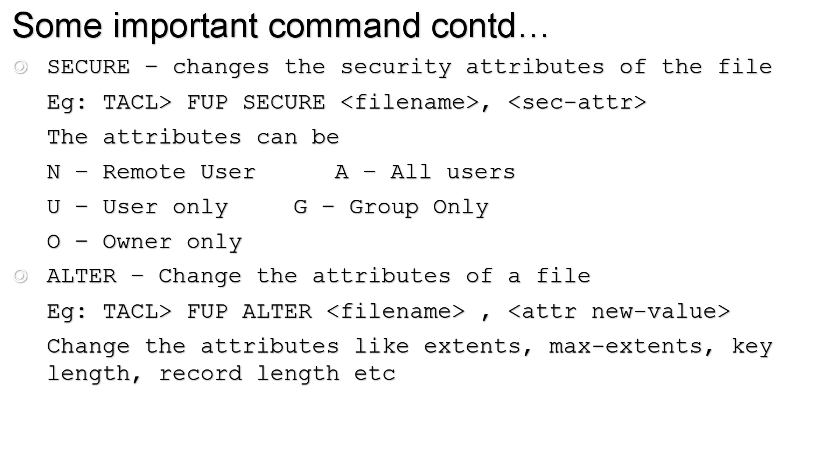
FUP

Slide 21
FUP
Practicals

Slide 22


Slide 23
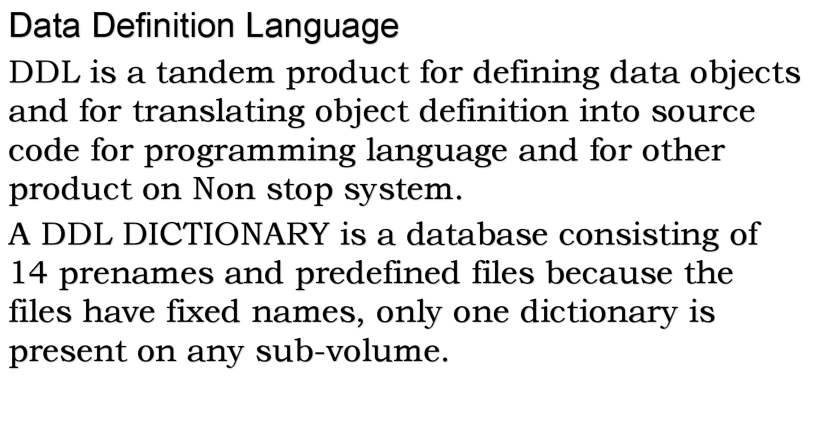
DDL

Slide 24
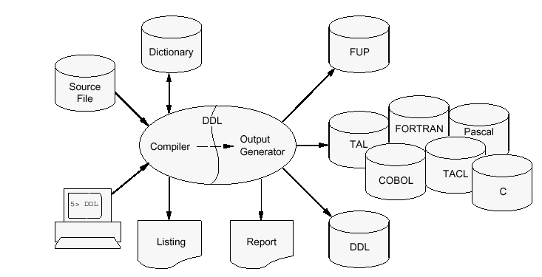
DDL OVERVIEW

Slide 25
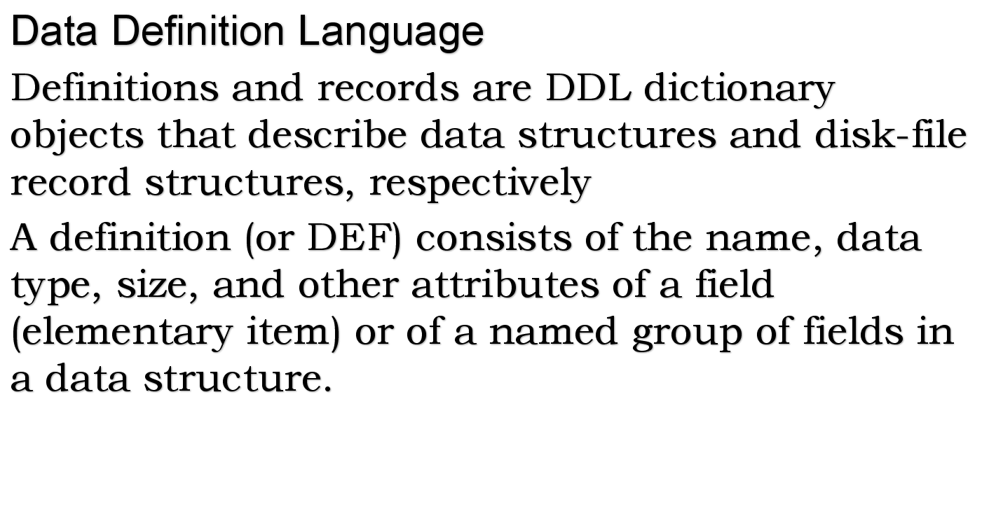
DDL

Slide 26
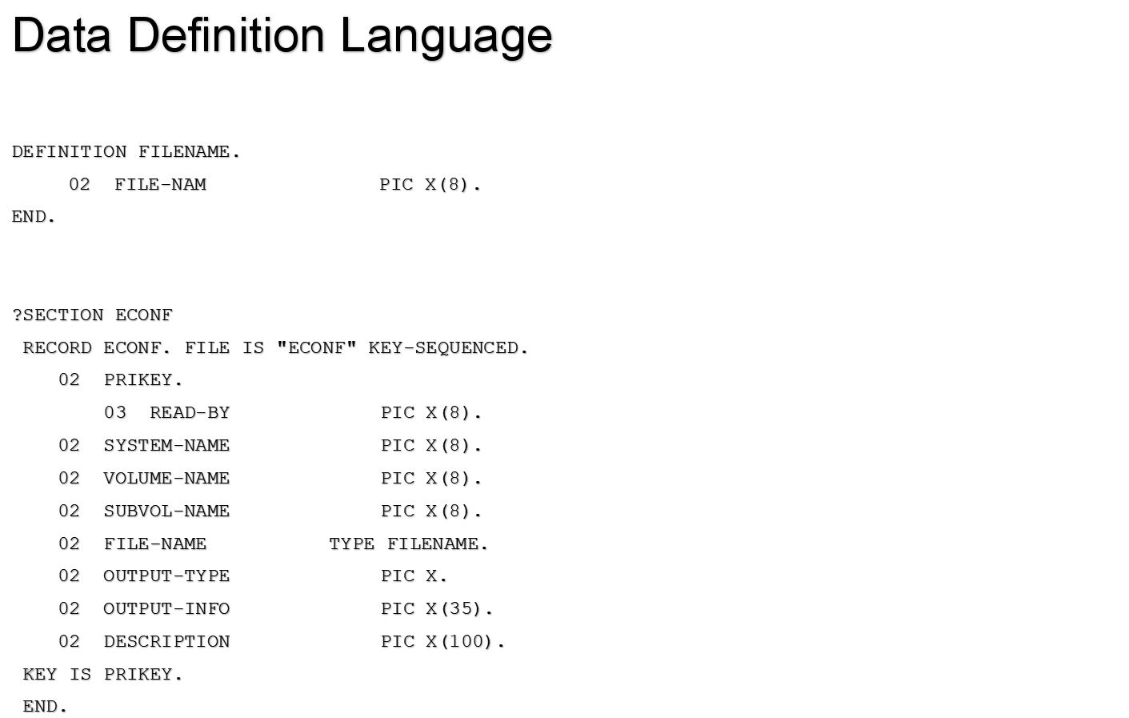
DDL

Slide 27
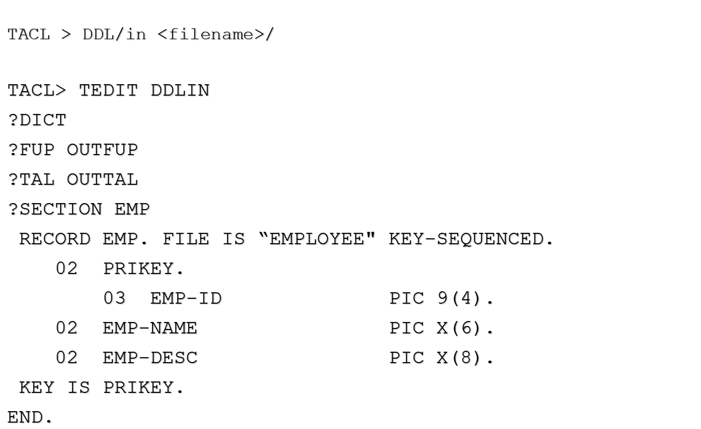
DDL Compilation

Slide 28
DDL
Practicals

Slide 29
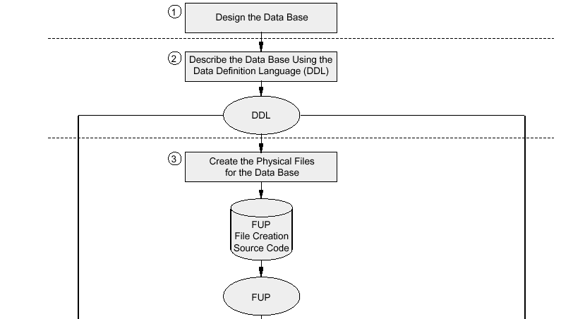

OVERVIEW TO ENFORM

Slide 30
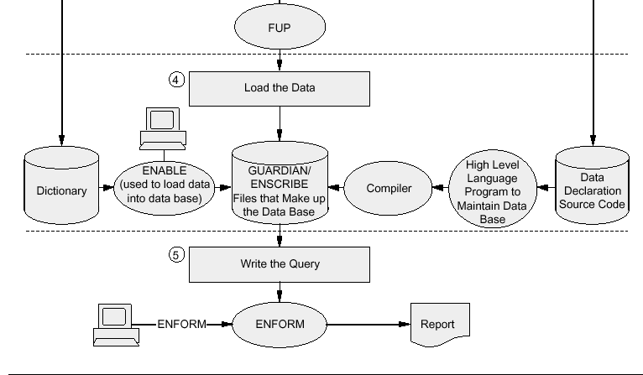
OVERVIEW CONTD....

Slide 31
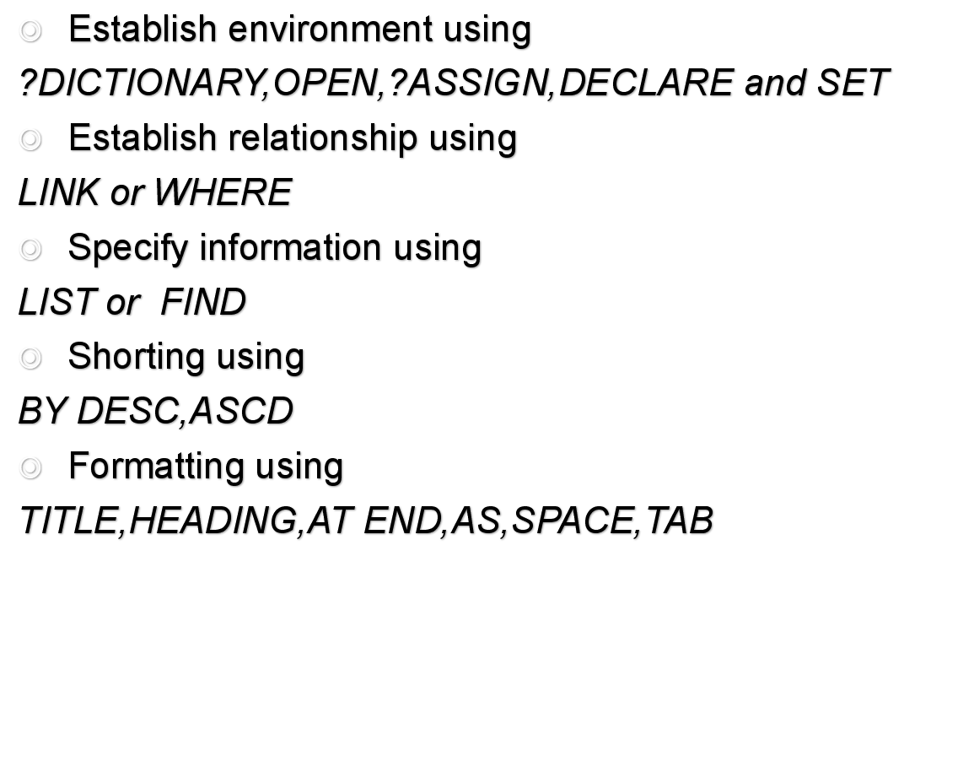
Developing Enform query

Slide 32
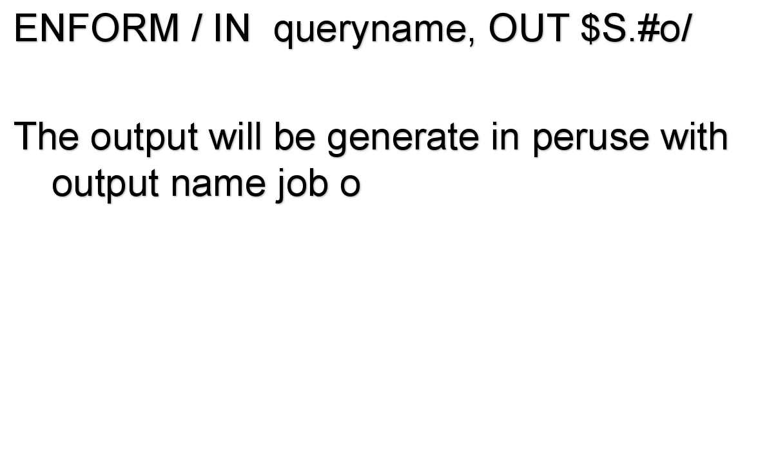
Compiling Enform query

Slide 33
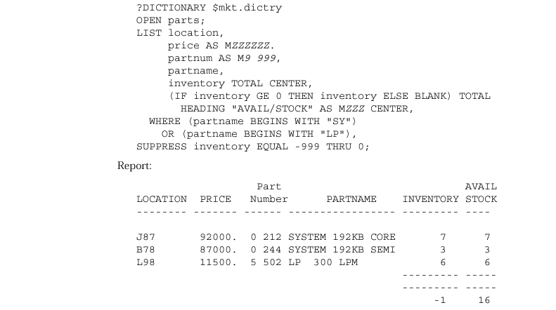
Sample Query and its Output

Slide 34
Thank you

